Slide 1
BIOE 498 / BIOE 599
Advanced Biological Control Systems
Design of Full State Feedback
Joseph L. Hellerstein
eScience Institute, Computer Science & Engineering
Allen School of Computer Science
BioEngineering
Notes:
Diverse students. Some with bio-backgrounds; some without. Some with CS background; some with very limited. Two separate courses combined because of a substantial shared curriculum.

Slide 2


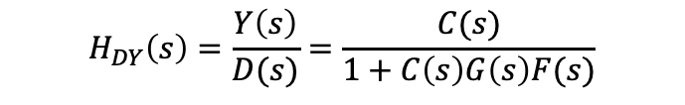



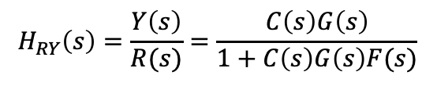


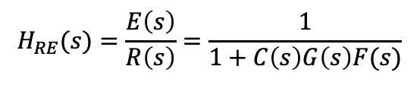


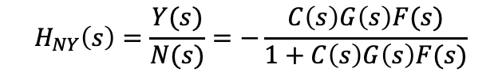

Closed Loop System
Actuator
Disturbance
Measurement
Noise
$$D(s)$$
$$N(s)$$
$$R(s)$$
$$E(s)$$
$$U(s)$$
$$Y(s)$$
$$C(s)$$
$$G(s)$$
+
+
+
$$−$$
$$F(s)$$
$$H_{RY}\left(s\right)=\frac{Y\left(s\right)}{R(s)}=\frac{C\left(s\right)G\left(s\right)}{1+C\left(s\right)G\left(s\right)F(s)}$$
$$H_{RE}(s)=\frac{E\left(s\right)}{R\left(s\right)}=\frac{1}{1+C\left(s\right)G\left(s\right)F(s)}$$
$$H_{NY}\left(s\right)=\frac{Y(s)}{N(s)}=−\frac{C\left(s\right)G\left(s\right)F(s)}{1+C\left(s\right)G\left(s\right)F(s)}$$
$$H_{DY}\left(s\right)=\frac{Y\left(s\right)}{D(s)}=\frac{C(s)}{1+C\left(s\right)G\left(s\right)F(s)}$$
Notes:
Why doesn’t a filter help with measurement noise? Verify transfer functions.

Slide 3












The Design Problem
Suppose that the poles of the System Under Control (SUC) are too close to 0, or even positive.
$$R(s)$$
$$E(s)$$
$$U(s)$$
$$Y(s)$$
$$C(s)$$
$$G(s)$$
+
$$−$$
Assuming that the controller has full knowledge of SUC state, we want to design a controller so that the closed loop system has more desirable poles.
$$R(s)$$
$$U(s)$$
$$Y(s)$$
$$C(s)$$
$$G(s)$$
X$(s)$
Notes:
Note that X(s) is a vector

Slide 4
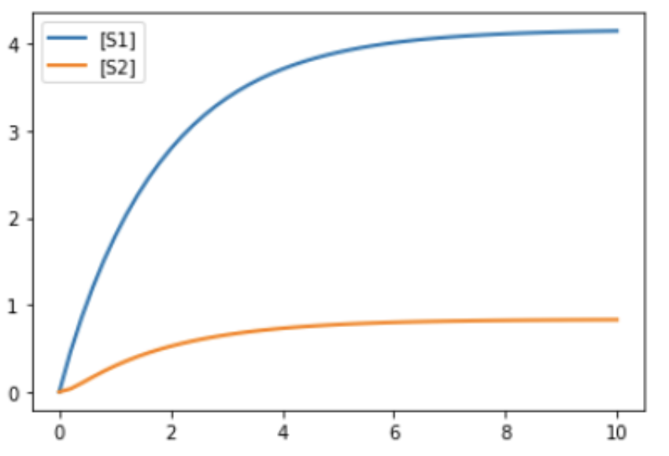



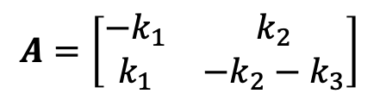
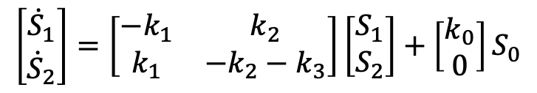
A Simple Example
S0->S1; k0*S0
S1->S2; k1*S1
S2->S1; k2*S2
S2-> ; k3*S2
k0=0.5; k1=1; k2=2; k3=3
$${\dot{S}}_{1}=−k_{1}S_{1}+k_{0}S_{0}+k_{2}S_{2}$$
$${\dot{S}}_{2}=k_{1}S_{1}−k_{2}S_{2}−k_{3}S_{2}$$
$$\left[\begin{matrix}{\dot{S}}_{1} \\ {\dot{S}}_{2}\end{matrix}\right]=\left[\begin{matrix}−k_{1} & k_{2} \\ k_{1} & −k_{2}−k_{3}\end{matrix}\right]\left[\begin{matrix}S_{1} \\ S_{2}\end{matrix}\right]+\left[\begin{matrix}k_{0} \\ 0\end{matrix}\right]S_{0}$$
$$A=\left[\begin{matrix}−k_{1} & k_{2} \\ k_{1} & −k_{2}−k_{3}\end{matrix}\right]$$
Objective: Stablize the closed loop system by 1 s.
Change the poles to $λ_{1},λ_{2}$

Slide 5

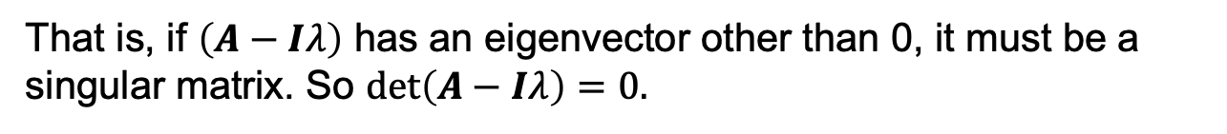
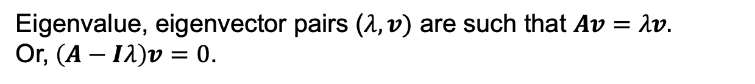
Finding Eigenvalues (Poles) for $A$
Eigenvalue, eigenvector pairs ($λ, v)$ are such that $Av=λv.$
Or,$\left(A−Iλ\right)v=0$.
That is, if $\left(A−Iλ\right)$ has an eigenvector other than 0, it must be a singular matrix. So $det\left(A−Iλ\right)=0.$
Characteristic polynomial
$$p_{A}\left(λ\right)=det\left(A−Iλ\right)=λ^{n}+a_{n−1}λ^{n−1 }+⋯+a_{0}$$
Characteristic equation
$$p_{A}\left(λ\right)=0≡det\left(A−Iλ\right)=0$$
Notes:
Specify the dimensions of the matrices and their products.

Slide 6


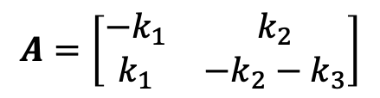

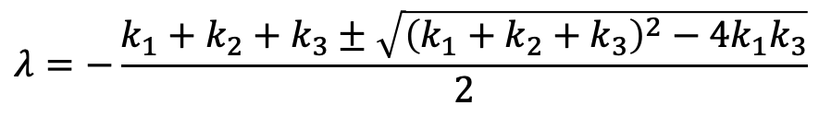
Poles in the Running Example
$$A=\left[\begin{matrix}−k_{1} & k_{2} \\ k_{1} & −k_{2}−k_{3}\end{matrix}\right]$$
The poles are the eigenvalues of $A$.
$$p_{A}\left(λ\right)=det\left(A−λI\right)=\left(−k_{1}−λ\right)\left(−k_{2}−k_{3}−λ\right)−k_{1}k_{2}$$
$$=λ^{2}+\left(k_{1}+k_{2}+k_{3}\right)λ+k_{1}k_{3}$$
$$λ=−\frac{k_{1}+k_{2}+k_{3}±\sqrt{{\left(k_{1}+k_{2}+k_{3}\right)}^{2}−4k_{1}k_{3}}}{2}$$
$$λ∈\{−0.54, −5.5\}$$

Slide 7



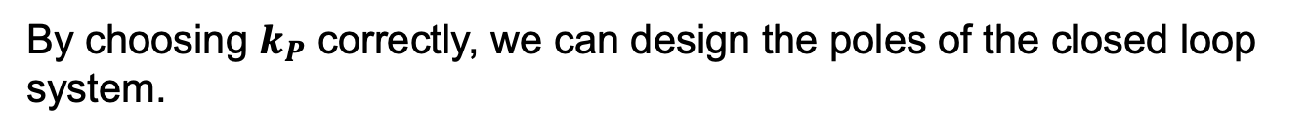







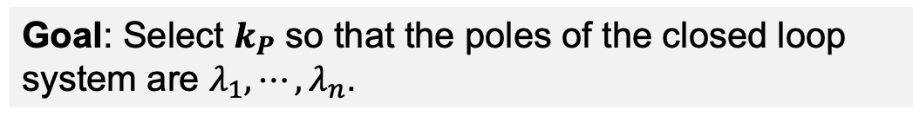

Formalizing The Design Problem
R$(s)$
$$C(s)$$
$$U(s)$$
$$Y(s)$$
$$G(s)$$
X$(s)$
$$\dot{x}\left(t\right)=Ax\left(t\right)+bu(t)$$
Dynamics of SUC in closed loop
$$u\left(t\right)={r\left(t\right)−k}_{P}x(t)$$
Controller operation
$\dot{x}\left(t\right)=Ax\left(t\right)−bk_{P}x\left(t\right)$+ $b r(t)$
Dynamics of the closed loop system
$\dot{x}\left(t\right)=(A−bk_{P})x\left(t\right)$ + $b r(t)$
By choosing $k_{P}$ correctly, we can design the poles of the closed loop system.
This is because the poles of the closed loop system are the eigenvalues of $A−bk_{P}$.
Goal: Select $k_{P}$ so that the poles of the closed loop system are $λ_{1},⋯, λ_{n}$.
Notes:
Specify the dimensions of the matrices and their products.

Slide 8
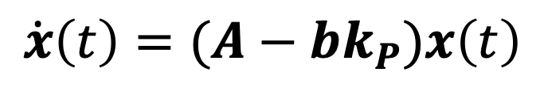




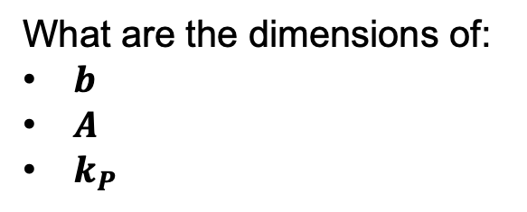


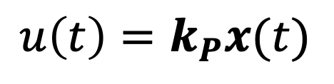

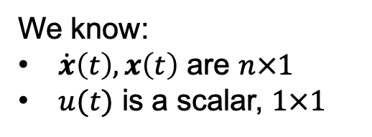










Solving for Closed Loop Poles:
Dimensions of Vector & Matrices
$$C(s)$$
$$U(s)$$
$$Y(s)$$
$$G(s)$$
X$(s)$
$$\dot{x}\left(t\right)=Ax\left(t\right)+bu(t)$$
$$u\left(t\right)=k_{P}x(t)$$
$$\dot{x}\left(t\right)=\left(A−bk_{P}\right)x\left(t\right)+br(t)$$
We know:
$\dot{x}\left(t\right), x\left(t\right)$ are $n×1$
$u(t)$ is a scalar, $1×1$
$$u\left(t\right)=k_{P}x(t)$$
What are the dimensions of:
$b$
$A$
$k_{P}$
1$×1$
}
1$×n$
$$n×1$$
$$n×1$$
$$n×n$$
$$n×n$$
1$×n$
$$n×n$$
}
$$\dot{x}\left(t\right)=(A−bk_{P})x\left(t\right)$$
$$n×1$$
$$n×n$$
$$n×1$$
1$×n$
$$n×1$$
Notes:
Specify the dimensions of the matrices and their products.

Slide 9
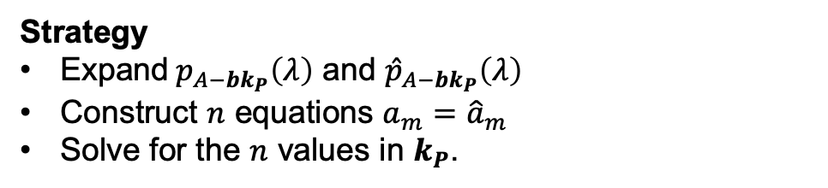


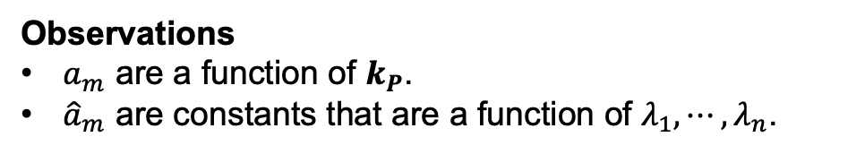
Solving for Closed Loop Poles:
Solution Strategy
$$\dot{x}\left(t\right)=(A−bk_{P})x\left(t\right)$$
(Suffices to consider the homogenous system)
$$p_{A−bk_{P}}\left(λ\right)=λ^{n}+a_{n−1}λ^{n−1 }+⋯+a_{0}$$
We want the poles to be $λ_{1},⋯,λ_{n}$.
That is, we want the characteristic polynomial to be
$${\hat{p}}_{A−bk_{P}}\left(λ\right)=\left(λ−λ_{1}\right)⋯\left(λ−λ_{n}\right)=λ^{n}+{\hat{a}}_{n−1}λ^{n−1 }+⋯+{\hat{a}}_{0}$$
Observations
$a_{m}$ are a function of $k_{P}$.
${\hat{a}}_{m}$ are constants that are a function of $λ_{1},⋯,λ_{n}$.
Strategy
Expand$p_{A−bk_{P}}\left(λ\right)$ and ${\hat{p}}_{A−bk_{P}}\left(λ\right)$
Construct $n$ equations $a_{m}={\hat{a}}_{m}$
Solve for the $n$ values in $k_{P}$.
Notes:
Specify the dimensions of the matrices and their products.

Slide 10
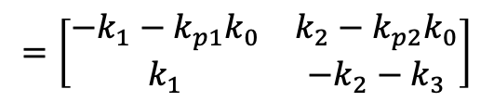

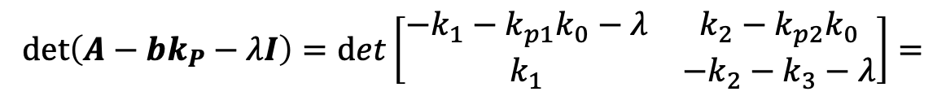
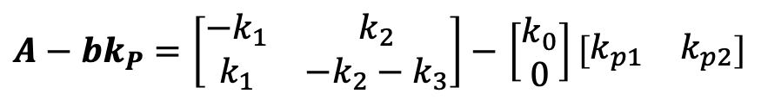






Running Example
$${\dot{S}}_{1}=−k_{1}S_{1}+k_{0}S_{0}+k_{2}S_{2}$$
$${\dot{S}}_{2}=k_{1}S_{1}−k_{2}S_{2}−k_{3}S_{2}$$
$$p_{A−bk_{P}}\left(λ\right)=\det\left(A−bk_{P}−λI\right){=λ}^{n}+a_{n−1}λ^{n−1 }+⋯+a_{0}$$
$A−bk_{P}=\left[\begin{matrix}−k_{1} & k_{2} \\ k_{1} & −k_{2}−k_{3}\end{matrix}\right]−$ $\left[\begin{matrix}k_{0} \\ 0\end{matrix}\right]\left[\begin{matrix}k_{p1} & k_{p2}\end{matrix}\right]$
$$=\left[\begin{matrix}−k_{1}−k_{p1}k_{0} & k_{2}−k_{p2}k_{0} \\ k_{1} & −k_{2}−k_{3}\end{matrix}\right]$$
{
$$k_{P}$$
$$\det\left(A−bk_{P}−λI\right)=det\left[\begin{matrix}−k_{1}−k_{p1}k_{0}−λ & k_{2}−k_{p2}k_{0} \\ k_{1} & −k_{2}−k_{3}−λ\end{matrix}\right]=$$
$$λ^{2}+{(k}_{1}+k_{2}+k_{3}+k_{0}k_{p1})λ−k_{1}k_{2}+k_{p2}k_{0}k_{1}+k_{p1}k_{0}\left(k_{2}+k_{3}\right)+k_{1}\left(k_{2}+k_{3}\right)$$
$$a_{1}=k_{1}+k_{2}+k_{3}+k_{0}k_{p1}$$
$a_{2}=k_{p2}k_{0}k_{1}+k_{p1}k_{0}\left(k_{2}+k_{3}\right)$ $+k_{1}k_{3}$
$${\hat{p}}_{A+bk_{P}}\left(λ\right)=\left(λ_{1}−λ\right)\left(λ_{2}−λ\right)=λ^{2}−\left(λ_{1}+λ_{2}\right)+λ_{1}+λ_{2}$$
$${\hat{a}}_{1}=−(λ_{1}+λ_{2})$$
$${\hat{a}}_{2}=λ_{1}λ_{2}$$

Slide 11











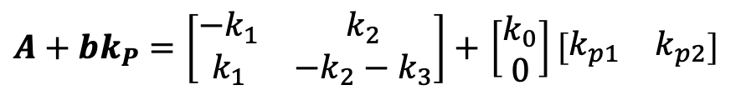


Solve for $k_{P}$
$A+bk_{P}=\left[\begin{matrix}−k_{1} & k_{2} \\ k_{1} & −k_{2}−k_{3}\end{matrix}\right]+$ $\left[\begin{matrix}k_{0} \\ 0\end{matrix}\right]\left[\begin{matrix}k_{p1} & k_{p2}\end{matrix}\right]$
{
$$k_{P}$$
$$p_{A+bk_{P}}\left(λ\right)=λ^{n}+a_{n−1}λ^{n−1 }+⋯+a_{0}$$
Characteristic polynomial
$${\hat{p}}_{A+bk_{P}}\left(λ\right)=\left(λ−λ_{1}\right)⋯\left(λ−λ_{n}\right)=λ^{n}+{\hat{a}}_{n−1}λ^{n−1 }+⋯+{\hat{a}}_{0}$$
Desired characteristic polynomial
From $p_{A+bk_{P}}\left(λ\right)$, we know that:
$$a_{1}=k_{1}+k_{2}+k_{3}+k_{0}k_{p1}$$
$a_{2}=k_{p2}k_{0}k_{1}$ $+k_{p1}k_{0}\left(k_{2}+k_{3}\right)$ $+k_{1}k_{3}$
From ${\hat{p}}_{A+bk_{P}}\left(λ\right)$, we know that:
$${\hat{a}}_{1}=−(λ_{1}+λ_{2})$$
$${\hat{a}}_{2}=λ_{1}λ_{2}$$
Solve for $k_{P}=\left[\begin{matrix}k_{p1} & k_{p2}\end{matrix}\right]$ using:
$${\hat{a}}_{1}=a_{1}$$
$k_{1}+k_{2}+k_{3}+k_{0}k_{p1}=$ $−(λ_{1}+λ_{2})$
$${\hat{a}}_{2}=a_{2}$$
$k_{p2}k_{0}k_{1}+{k_{p1}k}_{0}\left(k_{2}+k_{3}\right)$ $+ k_{1}k_{3}=λ_{1}λ_{2}$
Notes:
Show how to check algebra by considering k_p = 0 and expecting the eigenvalues of the original system.

Slide 12
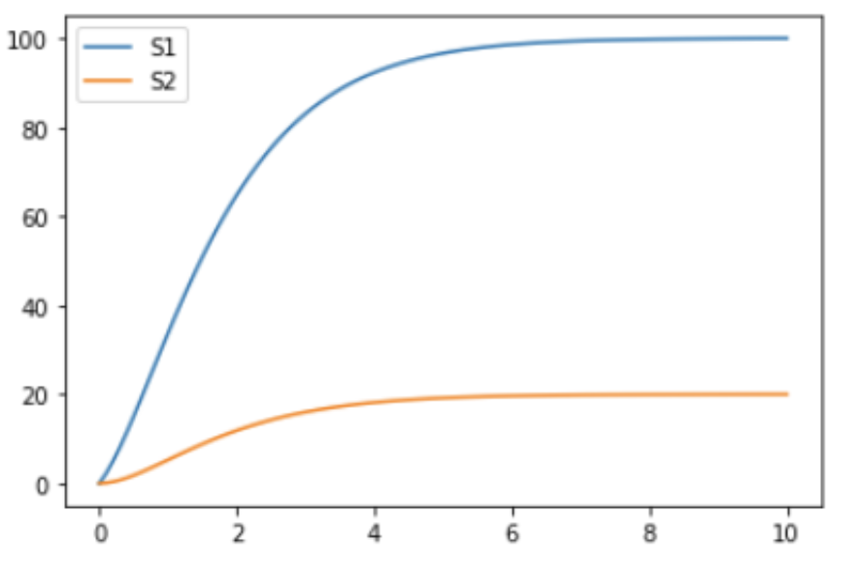
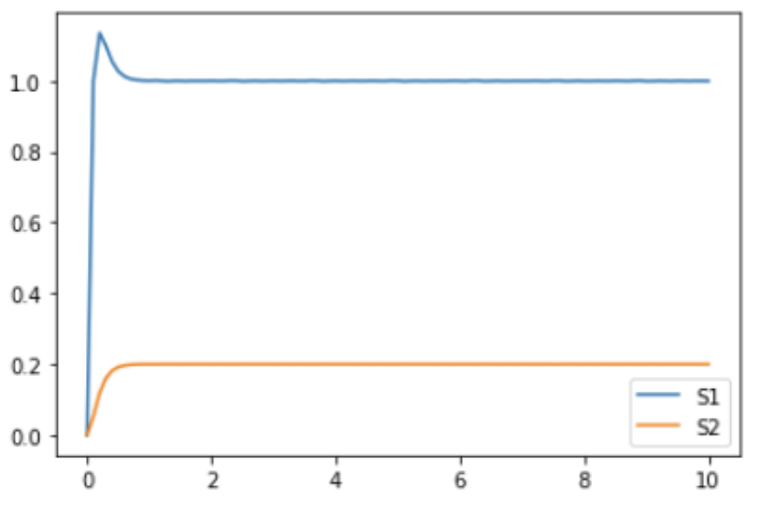
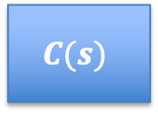

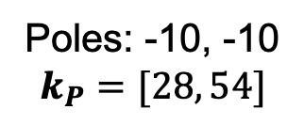




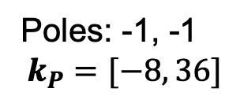
How Well Does State Feedback Work?
$$R(s)$$
$$U(s)$$
$$Y(s)$$
$$C(s)$$
$$G(s)$$
Uncontrolled
Poles: -0.54, -5.5
X$(s)$
Step Response
Poles: -1, -1
$$k_{P}=[−8, 36]$$
Poles: -10, -10
$$k_{P}=[28, 54]$$
The DC gain changes with the poles.

Slide 13
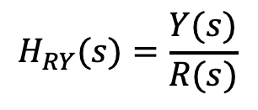











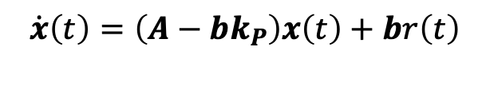
Adjusting for DC Gain of Controller
$$R(s)$$
$$U(s)$$
$$Y(s)$$
$$\dot{x}\left(t\right)=\left(A−bk_{P}\right)x\left(t\right)+br(t)$$
$$C(s)$$
$$G(s)$$
$$y\left(t\right)=cx(t)$$
X$(s)$
$$H_{RY}(s)=\frac{Y(s)}{R(s)}$$
$$sX(s)=\left(A−bk_{P}\right)X\left(s\right)+bR(s)$$
$$X\left(s\right)={\left(sI−A+bk_{P}\right)}^{−1}bR(s)$$
$$H_{RY}(0)={c\left(−A+bk_{P}\right)}^{−1}b$$
}
$$H_{RY}(s)={c\left(sI−A+bk_{P}\right)}^{−1}b$$
1$×1$
1$×n$
$$n×1$$
$$n×n$$
Adjusted State Equations
$$\dot{x}\left(t\right)=\left(A−bk_{P}\right)x\left(t\right)+br\left(t\right)$$
$$y(t)=\frac{c}{H_{RY}(0)}x\left(t\right)$$

Slide 14
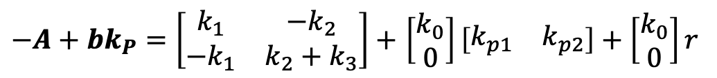
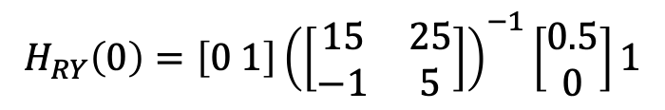
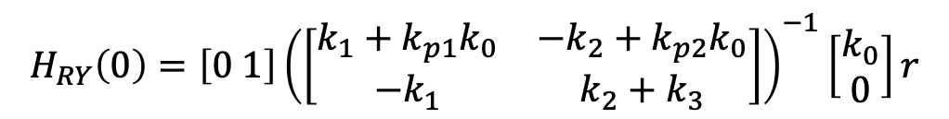




DC Gain in Running Example
$$H_{RY}(0)={c\left(−A+bk_{P}\right)}^{−1}b$$
$−A+bk_{P}=\left[\begin{matrix}k_{1} & −k_{2} \\ {−k}_{1} & k_{2}+k_{3}\end{matrix}\right]+$ $\left[\begin{matrix}k_{0} \\ 0\end{matrix}\right]\left[\begin{matrix}k_{p1} & k_{p2}\end{matrix}\right]+\left[\begin{matrix}k_{0} \\ 0\end{matrix}\right]r$
Poles: -10, -10
$$k_{P}=[28, 54]$$
$$c=[0 1]$$
$$H_{RY}\left(0\right)={\left[0 1\right]\left(\left[\begin{matrix}k_{1}+k_{p1}k_{0} & {−k}_{2}+k_{p2}k_{0} \\ −k_{1} & k_{2}+k_{3}\end{matrix}\right]\right)}^{−1}\left[\begin{matrix}k_{0} \\ 0\end{matrix}\right]r$$
$$r=1, k_{P}=[28 54]$$
$$H_{RY}\left(0\right)={\left[0 1\right]\left(\left[\begin{matrix}15 & 25 \\ −1 & 5\end{matrix}\right]\right)}^{−1}\left[\begin{matrix}0.5 \\ 0\end{matrix}\right]1$$

Slide 15










PID Closed Loop System
Actuator
Disturbance
Measurement
Noise
$$D(s)$$
$$N(s)$$
$$R(s)$$
$$E(s)$$
$$U(s)$$
$$Y(s)$$
$$C(s)$$
$$G(s)$$
+
+
+
$$−$$
$$F(s)$$

Slide 16





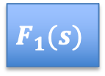









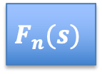
Full State Control With Filters
$$R(s)$$
$$C(s)$$
$$U(s)$$
$$Y(s)$$
$$G(s)$$
X$(s)$
Full State Feedback With Filters
$$D(s)$$
$$R(s)$$
$$U(s)$$
$$Y(s)$$
$$C(s)$$
$$G(s)$$
+
X$(s)$
+
$$N(s)$$
$$F_{1}(s)$$
$$F_{n}(s)$$
Notes:
Point out which are scalars and which are vectors.

